Slide 1



PERFORMANCE COMPARISON OF CONVOLUTIONAL NEURAL NETWORK TRAINING ON CPU AND GPU
A Project by
- Amith Ramaswamy
ID - 02139475

Slide 2
INTRODUCTION
Importance of Hardware in Deep Learning
Hardware plays a pivotal role in the performance and efficiency of deep learning tasks.
The choice of hardware significantly impacts the speed and effectiveness of model training.
Focus on CPU and GPU Efficiency Comparison
This study concentrates on evaluating the computational efficiency between two key hardware configurations: the Intel Core i5 13 gen and the Nvidia RTX 3050.
Specifically, the comparison emphasizes the efficiency of these configurations in training Convolutional Neural Networks (CNNs) for image classification tasks.

Slide 3
HARDWARE CONFIGURATIONS
Intel Core i5:
A 13th Gen CPU equipped with 12 cores.
Known for its robust computational capabilities and multi-core architecture.
Nvidia RTX 3050 GPU:
A specialized graphics processing unit renowned for its parallel processing capabilities.
Employed for accelerated parallelized computations in deep learning tasks.

Slide 4
Project Overview
Project Goals and Objectives
Objective 1: Hardware Comparison
Evaluate and compare the computational efficiency of training Convolutional Neural Networks (CNNs) on two distinct hardware configurations: Intel Core i5 and Nvidia RTX 3050.
Objective 2: Performance Metrics
Assess key metrics such as training time, model accuracy, and efficiency to gauge the effectiveness of each hardware setup.
Use of CIFAR-10 Dataset
Dataset Selection: CIFAR-10
The project employs the CIFAR-10 dataset, a widely recognized benchmark for image classification tasks.
CIFAR-10 consists of 60,000 32x32 color images across 10 classes, providing a diverse set of images for evaluating model generalization.

Slide 5
CUDA and cuDNN
CUDA (Compute Unified Device Architecture)
Parallel Computing Power:
CUDA harnesses the parallel processing capabilities of Nvidia GPUs for general-purpose computing.
Enables developers to achieve faster computation through parallel execution of tasks
cuDNN (CUDA Deep Neural Network library)
GPU-Accelerated Deep Learning:
cuDNN is a GPU-accelerated library for deep neural networks, building on CUDA.
Offers highly optimized implementations for essential deep learning primitives.

Slide 6
COMPARISON
CPU Computation
Training Time (2 epochs): 652 seconds
Model Accuracy: 67%
Efficiency: 52
GPU Computation
Training Time (2 epochs): 115 seconds
Model Accuracy: 66.8%
Efficiency: 115

Slide 7
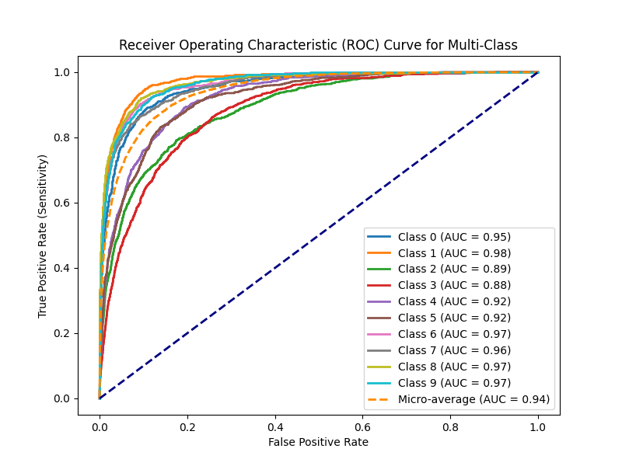
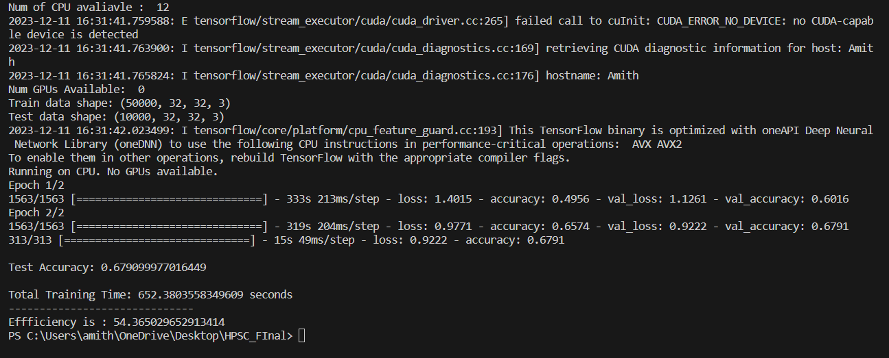
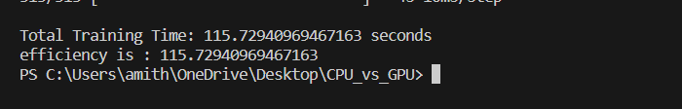
RESULTS

Slide 8

CONCLUSION
Significant Speedup:
GPU implementation with Nvidia RTX 3050 exhibited a remarkable increase in processing speed compared to the CPU.
Efficient Utilization of Parallelization:
The reduced training time signifies the efficient harnessing of GPU parallelization capabilities.
Comparable Accuracy:
Achieved accuracy on the GPU is comparable to the CPU, demonstrating that parallelized training did not compromise model performance.

Slide 9
FUTURE SCOPE
Different Deep learning models can be implemented and compared
Can increase the number of epochs to increase the model performance

Slide 10
GETTING STARTED
You can access the code through my github (https://github.com/amith-2001/CPU_vs_GPU)
Install CUDA and cuDNN drivers on your machine
Install the requirements provided in the repository
Run the code

Slide 11
Thank You

Slide 12
REFERENCES
[1] https://www.intel.com/content/www/us/en/products/docs/processors/core/13th-gen-processors.html#:~:text=The%2013th%20Gen%20Intel%C2%AE%20Core%E2%84%A2%20processor%20family%20offers,multitasking%20and%20choice%20for%20configurability.
[2] https://www.nvidia.com/download/index.aspx
[3] https://developer.nvidia.com/cudnn
[4] https://docs.nvidia.com/cuda/cuda-installation-guide-microsoft-windows/index.html
[5] https://www.youtube.com/watch?v=OEFKlRSd8Ic

